Slide 1
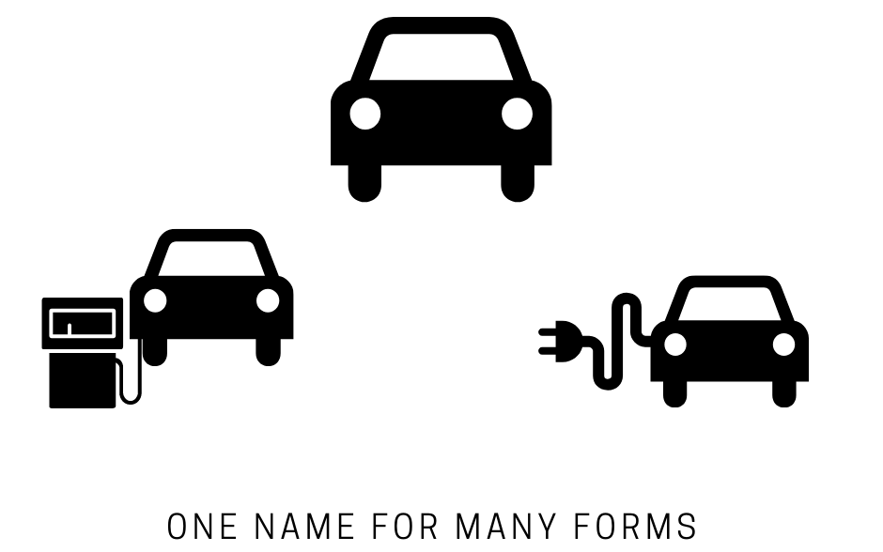
Polymorphism
Polymorphism, Override and Overload Methods
SoftUni Team
Technical Trainers
Software University
https://softuni.bg

Slide 2
Table of Contents
Polymorphism
Is and As Operators – type-casting and compatibility checking
Types of Polymorphism
Compile-Time Polymorphism – overload methods
Run-Time Polymorphism – override methods

Slide 3


Ability of an Object to Take On Many Forms
ANIMAL

Slide 4
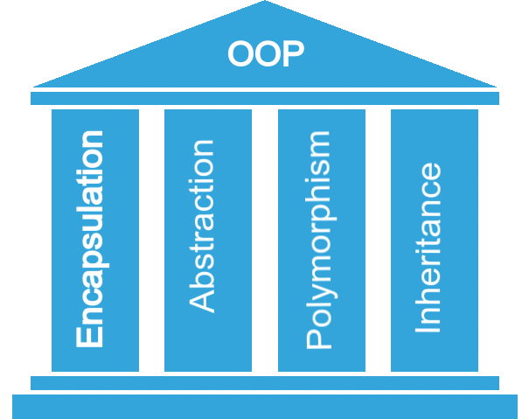
What is Polymorphism?
Polys
(many)
Morphe
(shape/forms)
Polymorphism is a Greek word, meaning "one name many forms"
Polymorphos
Pillar of object-oriented programming

Slide 5
Polymorphism in OOP
Ability of an object to take on many forms
Allows treating objects of a derived class as objects of its base class
IAnimal
Mammal
public interface IAnimal {}
public abstract class Mammal {}
public class Person : Mammal, IAnimal {}
Person
Person IS-AN Object
Person IS-A Mammal
new Person()
Person IS-A Person
Person IS-AN Animal
Object

Slide 6
Reference Type and Object Type
Variables are saved in a reference type
You can use only reference methods
If you need an object method you need to cast it or override it
public class Person : Mammal, IAnimal {}
IAnimal person = new Person();
Mammal personOne = new Person();
Person personTwo = new Person();
Reference Type
Object Type

Slide 7
Type-casting and Compatibility Checking
is
as

Slide 8
Keyword – is
Check if an object is an instance of а specific class
public class Person : Mammal, IAnimal {}
IAnimal person = new Person();
Mammal personOne = new Person();
Person personTwo = new Person();
if (person is Person)
{
((Person) person).getSalary();
}
Check object type of person
Cast to object type and use its methods

Slide 9
IS Type Pattern
is type pattern - tests whether an expression can be converted to a specified type and casts it to a variable of that type
public class Person : Mammal, IAnimal {}
Mammal personOne = new Person();
Person personTwo = new Person();
if (personTwo is Person person)
{
person.GetSalary();
}
Checks if object is of type person and casts it
Uses its methods

Slide 10
Keyword – As
as operator is used for conversions between compatible reference types
public class Person : Mammal, Animal {}
Animal person = new Person();
Mammal personOne = new Person();
Person personTwo;
personTwo = personOne as Person;
if (personTwo != null)
{
// Do something specific for Person
}
Convert Mammal to Person
Check if conversion is successful

Slide 11
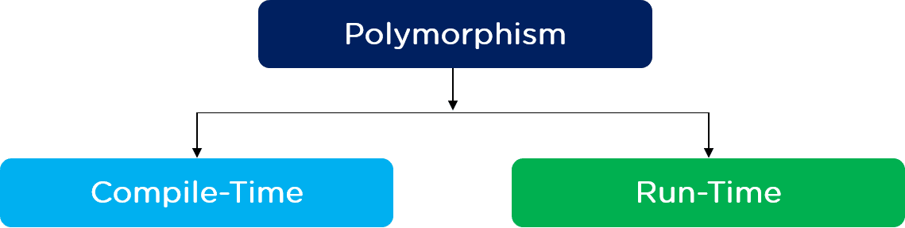
Compile-Time and Run-Time Polymorphism

Slide 12
Types of Polymorphism
Runtime
Compile time
public class Shape {}
public class Circle : Shape {}
public static void Main()
{
Shape shape = new Circle()
}
public static void Main()
{
int Sum(int a, int b, int c)
double Sum(Double a, Double b)
}
12

Slide 13
Overloading
Method(x)
Class
Method(x,y)
Method(y,x)

Slide 14
Compile Time Polymorphism
Also known as Static Polymorphism – realized by overloading
Argument lists could differ in:
Number of parameters
Data type of parameters
Order of parameters
public static void Main()
{
static int MyMethod(int a, int b) {…}
static double MyMethod(double a, double b) {…}
static int MyMethod(int b, int a, int c) {…}
}
Method overloading – same name but different implementation

Slide 15
Problem: MathOperation
MathOperation
+Add(int, int): int
+Add(double, double, double): double
+Add(decimal, decimal, decimal): decimal
MathOperations mo = new MathOperations();
Console.WriteLine(mo.Add(2, 3));
Console.WriteLine(mo.Add(2.2, 3.3, 5.5));
Console.WriteLine(mo.Add(2.2m, 3.3m, 4.4m));
Notes:
(c) 2006 National Academy for Software Development - http://academy.devbg.org*
15##

Slide 16
Solution: MathOperation
public int Add(int a, int b)
{
return a + b;
}
public double Add(double a, double b, double c)
{
return a + b + c;
}
public decimal Add(decimal a, decimal b, decimal c)
{
return a + b + c;
}
Check your solution here: https://judge.softuni.bg/Contests/Practice/Index/3167#0
Notes:
(c) 2006 National Academy for Software Development - http://academy.devbg.org*
16##

Slide 17
Rules for Overloading a Method (1)
Signature must be different, either:
Number of arguments
Type of arguments
Order of arguments
Return type is not a part of its signature
Overloading can take place in the same class or in its sub-classes
Constructors can be overloaded

Slide 18
Rules for Overloading a Method (2)
Different number and type of arguments
class Calculator
{
public int Add(int a, int b) { return a + b; }
public int Add(int a, int b, int c) { return a + b + c; }
public double Add(double a, double b) { return a + b; }
}
static void Main(){
Calculator calc = new Calculator();
int sum1 = calc.Add(1, 2);
int sum2 = calc.Add(1, 2, 3);
int sum3 = calc.Add(1.0, 2.3, 3.1);
}

Slide 19
Rules for Overloading a Method (3)
Different order of arguments
class Guest {
string Identity(string name, int id)
{ return $"{name} + {id}"; }
void Identity(int id, string name)
{ return $"{name} + {id}"; }
}
static void Main()
{
Guest guest = new Guest();
string guest1 = guest.Identity("Stephen", 15);
string guest2 = guest.Identity(15, "Stephen");
}

Slide 20
Same Signatures Different Return Type
You cannot declare two methods with the same signature and different return type
static void Print(string text)
{
Console.WriteLine("Printing");
}
static string Print(string text)
{
return "Printing";
}

Slide 21
Overriding
Shape
draw()
Square class
Hexagon class
Circle class
draw()
draw()
draw()

Slide 22
Runtime Polymorphism (1)
Also known as Dynamic Polymorphism – realized by override a base class function using virtual or override keyword
public class Rectangle
{
public virtual double Area()
{
return this.a * this.b;
}
}
public class Square : Rectangle
{
public override double Area()
{ return this.a * this.a;
}
}
Own definition and implementation
Notes:
Demo (look at View -> Notes Page)
public static void main(String[] args) {
Vegetarian babyDeer = new Deer();
Vegetarian babyElephant = new Elephant();
List<Vegetarian> vegetarianAnimals = new ArrayList<>();
vegetarianAnimals.add(babyDeer);
vegetarianAnimals.add(babyElephant);
}

Slide 23
Runtime Polymorphism (2)
Usage of override method
public static void Main()
{
Rectangle rect = new Rectangle(3.0, 4.0);
Rectangle square = new Square(4.0);
Console.WriteLine(rect.Area());
Console.WriteLine(square.Area());
}
Method overriding

Slide 24
Runtime Polymorphism (3)
At run time, objects of a derived class may be treated as objects of a base class
When this occurs, the object's declared type is no longer identical to its run-time type
public class Animal
{
…
}
public class Cat : Animal
{
…
}
Animal cat = new Cat();
declared type
run-time type

Slide 25
Problem: Animals
Implement the following class hierarchy:
Animal
string Name
string FavouriteFood
+ExplainSelf():string
Cat
Dog
+ ExplainSelf():string
+ ExplainSelf():string
Notes:
(c) 2006 National Academy for Software Development - http://academy.devbg.org*
25##

Slide 26
Solution: Animals (1)
public abstract class Animal
{ // Create Constructor
public string Name { get; private set; }
public string FavouriteFood { get; private set; }
public virtual string ExplainSelf()
{
return string.Format(
"I am {0} and my favourite food is {1}",
this.Name,
this.FavouriteFood);
}
}
Notes:
(c) 2006 National Academy for Software Development - http://academy.devbg.org*
26##

Slide 27
Solution: Animals (2)
public class Dog : Animal
{
public Dog(string name, string favouriteFood)
: base(name, favouriteFood) { }
public override string ExplainSelf()
{
return base.ExplainSelf() +
Environment.NewLine +
"BARK";
}
}
Notes:
(c) 2006 National Academy for Software Development - http://academy.devbg.org*
27##

Slide 28
Solution: Animals (3)
public class Cat : Animal
{
public Cat(string name, string favouriteFood)
: base(name, favouriteFood) { }
public override string ExplainSelf()
{
return base.ExplainSelf() +
Environment.NewLine +
"MEOW";
}
}
Check your solution here: https://judge.softuni.bg/Contests/Practice/Index/3167#1
Notes:
(c) 2006 National Academy for Software Development - http://academy.devbg.org*
28##

Slide 29
Rules for Overriding Method (1)
public class Rectangle
{
public virtual double Area()
{
return a * b;
}
}
virtual in base method
Private and static methods cannot be overridden
Same return type and signature
public class Square : Rectangle
{
public override double Area()
{ return a * a;
}
}
override or abstract in sub-classes

Slide 30
Rules for Overriding Method (2)
Virtual members use base keyword to call the base class
Extends the base class virtual method
class Bird
{
public virtual void Fly()
{
Console.Write("Flying");
}
}
class Swallow : Bird
{
public override void Fly()
{
base.Fly();
Console.WriteLine("Hunt");
}
}
Can add specific behavior

Slide 31
Rules for Overriding Method (3)
A derived class can stop virtual inheritance by declaring an override as sealed
class Penguin : Bird
{
public sealed override void Fly() {}
}
class NewTypePenguin : Penguin
{
public new void Fly()
{
base.Fly();
}
}
Sealed methods can be replaced by derived classes by using the new keyword
The new modifier hides an accessible base class method

Slide 32

Summary
…
…
…
Polymorphism – ability of an object to take many forms
Types of polymorphism:
Compile-time
Performed through overloading – same method name but different implementation
Run-time
Performed through overriding – using virtual + override keywords

Slide 33
Questions?
Notes:
33

Slide 34

License
This course (slides, examples, demos, exercises, homework, documents, videos and other assets) is copyrighted content
Unauthorized copy, reproduction or use is illegal
© SoftUni – https://softuni.org
© Software University – https://softuni.bg
Notes:
34

